Slide 1
TSWGE Realization Generation Sine Cosine
https://docs.google.com/document/d/1sMA_x5Y7NUsNSjrmwLR09mGl-MD9s6csevmpBS367Wo/edit?usp=sharing
Notes:
They will need the following code and link to get started:
install.packages(“tswge”)
library(tswge)
data(global.temp)
data(wtcrude)
Google Doc Link:
https://docs.google.com/document/d/1sMA_x5Y7NUsNSjrmwLR09mGl-MD9s6csevmpBS367Wo/edit?usp=sharing
https://docs.google.com/document/d/1sMA_x5Y7NUsNSjrmwLR09mGl-MD9s6csevmpBS367Wo/edit?usp=sharing

Slide 2
Segment 2.3: Screen Share
In this screen cast, we will use tswge to generate realizations from a signal plus noise model with a sin and/or cos signal.
Description of the variables:
Identify the function… Xt = ….
#Code for generating random realizations from a NON stationary process
Xt1 = gen.sigplusnoise.wge(n = 1000,freq=c(.005,0),psi = c(runif(1,0,2*pi),0),vara = .00, coef = c(1,0),plot = TRUE)
Xt2 = gen.sigplusnoise.wge(n = 1000,freq=c(.005,0),psi = c(runif(1,0,2*pi),0),vara = .00, coef = c(1,0),plot = TRUE)
Xt3 = gen.sigplusnoise.wge(n = 1000,freq=c(.005,0),psi = c(runif(1,0,2*pi),0),vara = .00, coef = c(1,0),plot = TRUE)
par(mfrow = c(3,1))
plot(seq(0,1000,length = 1000),Xt1,main = "Realization 1 (Seed = 1): cos(t + 0)",type = "l",xlab = "",ylab = "", cex.axis = 1.5)
plot(seq(0,1000,length = 1000),Xt2,main = "Realization 2 (Seed = 2): cos(t + 0)",type = "l",xlab = "",ylab = "", cex.axis = 1.5)
plot(seq(0,1000,length = 1000),Xt3,main = "Realization 3 (Seed = 3): cos(t + 0)",type = "l",xlab = "",ylab = "", cex.axis = 1.5)
Notes:
No NOISE HERE!

Slide 4
Sine and Cosine Review
https://docs.google.com/document/d/1sMA_x5Y7NUsNSjrmwLR09mGl-MD9s6csevmpBS367Wo/edit?usp=sharing
Notes:
They will need the following code and link to get started:
install.packages(“tswge”)
library(tswge)
data(global.temp)
data(wtcrude)
Google Doc Link:
https://docs.google.com/document/d/1sMA_x5Y7NUsNSjrmwLR09mGl-MD9s6csevmpBS367Wo/edit?usp=sharing
https://docs.google.com/document/d/1sMA_x5Y7NUsNSjrmwLR09mGl-MD9s6csevmpBS367Wo/edit?usp=sharing

Slide 5
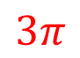
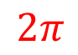
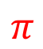
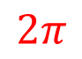
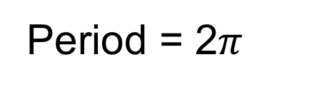
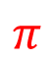
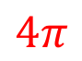
Sin(t)
t = seq(0,4*pi,length = 1000)
plot(t,sin(t))
Period = 2$π$
$$π$$
$$2π$$
$$3π$$
$$4π$$
t = seq(0,4*pi,length = 1000)
plot(t,sin(t))
$$π$$
$$2π$$

Slide 6

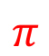
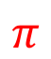

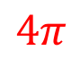
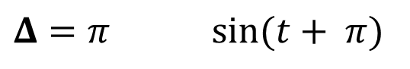
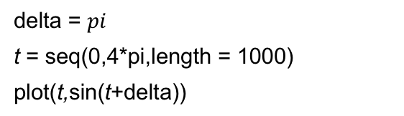
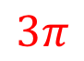
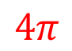
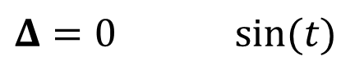
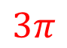
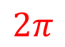
Sin(t+$Δ$): Phase Shift by $Δ$ Horizontal Shift Left by $Δ$
$$Δ=0 sin⁡(t)$$
t = seq(0,4*pi,length = 1000)
plot(t,sin(t))
$$π$$
$$2π$$
$$3π$$
$$4π$$
$$Δ=π sin⁡(t+ π)$$
delta = $pi$
t = seq(0,4*pi,length = 1000)
plot(t,sin(t+delta))
$$π$$
$$2π$$
$$3π$$
$$4π$$

Slide 7
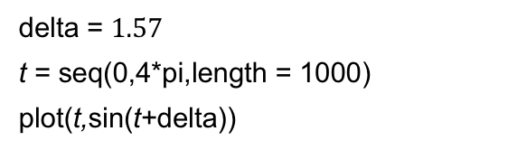
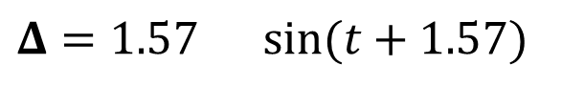
Sin(t+$Δ$): Phase Shift by $Δ$ Horizontal Shift Left by $Δ$
$$Δ=0 sin⁡(t)$$
t = seq(0,4*pi,length = 1000)
plot(t,sin(t))
$$π$$
$$2π$$
$$3π$$
$$4π$$
$$Δ=1.57 sin⁡(t+1.57)$$
delta = $1.57$
t = seq(0,4*pi,length = 1000)
plot(t,sin(t+delta))
$$π$$
$$2π$$
$$3π$$
$$4π$$

Slide 8
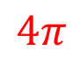
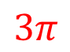
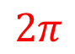
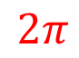

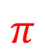
Cos(t)
x = seq(0,2*pi,length = 1000)
plot(x,cos(x))
$$π$$
$$2π$$
$$3π$$
$$4π$$
Period = 2$π$
x = seq(0,4*pi,length = 1000)
plot(x,cos(x))
$$π$$
$$2π$$

Slide 9
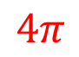
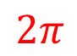
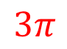


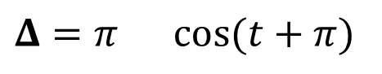
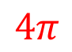
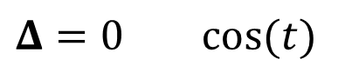
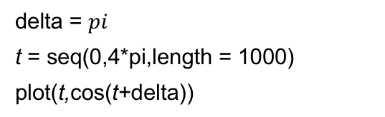
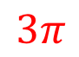
Cos(t+$Δ$): Phase Shift by $Δ$ Horizontal Shift Left by $Δ$
$$Δ=0 cos(t)$$
t = seq(0,4*pi,length = 1000)
plot(t,cos(t))
$$π$$
$$2π$$
$$3π$$
$$4π$$
$$Δ=π cos⁡(t+π)$$
delta = $pi$
t = seq(0,4*pi,length = 1000)
plot(t,cos(t+delta))
$$π$$
$$2π$$
$$3π$$
$$4π$$

Slide 10
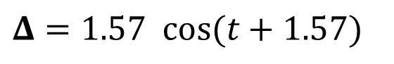
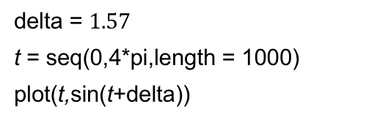
Cos(t+$Δ$): Phase Shift by $Δ$ Horizontal Shift Left by $Δ$
$$Δ=0 cos(t)$$
t = seq(0,4*pi,length = 1000)
plot(t,sin(t))
$$π$$
$$2π$$
$$3π$$
$$4π$$
$$Δ=1.57 cos(t+1.57)$$
delta = $1.57$
t = seq(0,4*pi,length = 1000)
plot(t,sin(t+delta))
$$π$$
$$2π$$
$$3π$$
$$4π$$

Slide 12
Stationary and Nonstationary Time Series
https://docs.google.com/document/d/1sMA_x5Y7NUsNSjrmwLR09mGl-MD9s6csevmpBS367Wo/edit?usp=sharing
Notes:
They will need the following code and link to get started:
install.packages(“tswge”)
library(tswge)
data(global.temp)
data(wtcrude)
Google Doc Link:
https://docs.google.com/document/d/1sMA_x5Y7NUsNSjrmwLR09mGl-MD9s6csevmpBS367Wo/edit?usp=sharing
https://docs.google.com/document/d/1sMA_x5Y7NUsNSjrmwLR09mGl-MD9s6csevmpBS367Wo/edit?usp=sharing

Slide 13
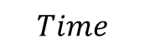
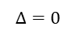
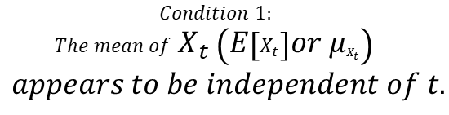
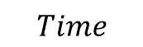
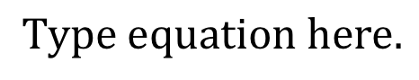
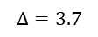
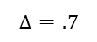

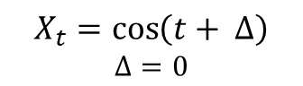

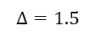
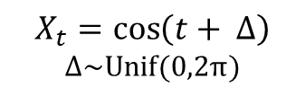
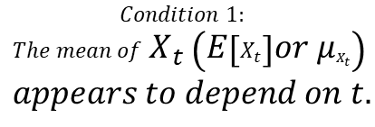
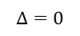
Below are 3 realizations from 2 different time series. Which provides the most evidence of a stationary time series?
#Code for generating NON stationary realizations
Xt1 = gen.sigplusnoise.wge(n = 1000,freq=c(.005,0),psi = c(0,0),vara = .00, coef = c(1,0),plot = TRUE,sn = 1)
Xt2 = gen.sigplusnoise.wge(n = 1000,freq=c(.005,0),psi = c(0,0),vara = .00, coef = c(1,0),plot = TRUE,sn = 2)
Xt3 = gen.sigplusnoise.wge(n = 1000,freq=c(.005,0),psi = c(0,0),vara = .00, coef = c(1,0),plot = TRUE,sn = 3)
par(mfrow = c(3,1))
plot(seq(0,1000,length = 1000),Xt1,main = "Realization 1 (Seed = 1): cos(t + 0)",type = "l",xlab = "",ylab = "", cex.axis = 1.5)
plot(seq(0,1000,length = 1000),Xt2,main = "Realization 2 (Seed = 2): cos(t + 0)",type = "l",xlab = "",ylab = "", cex.axis = 1.5)
plot(seq(0,1000,length = 1000),Xt3,main = "Realization 3 (Seed = 3): cos(t + 0)",type = "l",xlab = "",ylab = "", cex.axis = 1.5)
$$X_{t}=\cos\left(t+ Δ\right)$$
$$Δ=0$$
$$X_{t}=\cos\left(t+ Δ\right)$$
$$Δ\sim Unif(0,2π)$$
$$Δ=0$$
$$Δ=1.5$$
$$X_{t}$$
$$X_{t}$$
$$Δ=0$$
$$Δ=.7$$
$$Δ=0$$
$$Δ=3.7$$
#Code for generating stationary realizations
Xt1 = gen.sigplusnoise.wge(n = 1000,freq=c(.005,0),psi = c(runif(n = 1,min = 0, max = 2*pi),0),vara = .00, coef = c(1,0),plot = TRUE,sn = 1)
Xt2 = gen.sigplusnoise.wge(n = 1000,freq=c(.005,0),psi = c(runif(n = 1,min = 0, max = 2*pi),0),vara = .00, coef = c(1,0),plot = TRUE,sn = 2)
Xt3 = gen.sigplusnoise.wge(n = 1000,freq=c(.005,0),psi = c(runif(n = 1,min = 0, max = 2*pi),0),vara = .00, coef = c(1,0),plot = TRUE,sn = 4)
par(mfrow = c(3,1))
plot(seq(0,1000,length = 1000),Xt1,main = "Realization 1 (Seed = 1): cos(t + Delta)",type = "l",xlab = "",ylab = "", cex.axis = 1.5)
plot(seq(0,1000,length = 1000),Xt2,main = "Realization 2 (Seed = 2): cos(t + Delta)",type = "l",xlab = "",ylab = "", cex.axis = 1.5)
plot(seq(0,1000,length = 1000),Xt3,main = "Realization 3 (Seed = 3): cos(t + Delta)",type = "l",xlab = "",ylab = "", cex.axis = 1.5)
$$Time$$
$$Time$$
There appears to be evidence against stationarity.
The evidence appears to be consistent with a stationary series.
$$Condition 1:$$
$$The mean of{ X}_{t} \left(E\left[X_{t}\right]or μ_{X_{t}}\right)$$
$$appears to depend on t.$$
$$Condition 1:$$
$$The mean of{ X}_{t} \left(E\left[X_{t}\right]or μ_{X_{t}}\right)$$
$$appears to be independent of t.$$
Notes:
Eliminate the noise from these plots. And show all three deltas for each plot. (all 6)
SEGMENT 1: Review 1.4 Slide Deck: Review of Stationary and Non Stationary Series with functions and realizations from above.

Slide 15
Frequency/Period Review
https://docs.google.com/document/d/1sMA_x5Y7NUsNSjrmwLR09mGl-MD9s6csevmpBS367Wo/edit?usp=sharing
Notes:
They will need the following code and link to get started:
install.packages(“tswge”)
library(tswge)
data(global.temp)
data(wtcrude)
Google Doc Link:
https://docs.google.com/document/d/1sMA_x5Y7NUsNSjrmwLR09mGl-MD9s6csevmpBS367Wo/edit?usp=sharing
https://docs.google.com/document/d/1sMA_x5Y7NUsNSjrmwLR09mGl-MD9s6csevmpBS367Wo/edit?usp=sharing

Slide 16
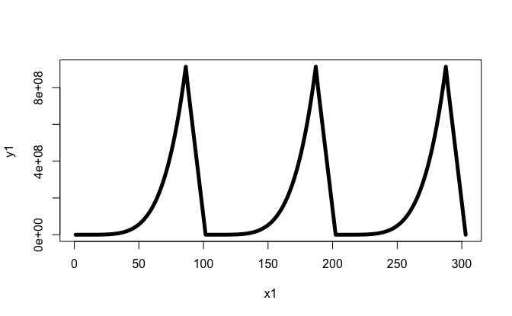
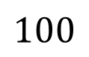
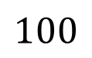
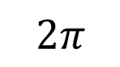




Spectral Analysis:
Analysis of Periodicities in the Data
x = seq(0,201,length = 202)
y = 3*x^5-4*x^4+8*x^3-2*x^2+x+1
y1 = c(y[1:51],c(800000000,700000000,600000000,500000000,400000000,300000000,200000000,100000000),y[1:51],c(800000000,700000000,600000000,500000000,400000000,300000000,200000000,100000000),y[1:51],c(800000000,700000000,600000000,500000000,400000000,300000000,200000000,100000000,0))
x1 = seq(1,303,length = 178)
plot(x1,y1,type = "l",lwd = 5)
Technical details
Periodic functions
f (x) is periodic function with period p if p is the smallest value such that f (x) = f (x + kp) for all x and integer k.
$$2π$$
$$2π$$
$$100$$
$$100$$
$$100$$
Period = $2π$
Period = $100$

Slide 17








Spectral Analysis:
Analysis of Periodicities in the Data
Technical details
Psuedo-periodic data
Data are pseudo-periodic with period p if p is the smallest value such that a cycle appears to repeat itself.
$$12 months$$
$$12 months$$
$$7 days$$
$$1 day$$
$$1 day$$
$$7 days$$
17

Slide 18


Spectral Analysis:
Analysis of Periodicities in the Data
Technical details
Aperiodic functions/data
f (x) is non-periodic (aperiodic) if no such p exists.

Slide 19



Spectral Analysis:
Analysis of Periodicities in the Data
Technical details
Frequency = number of cycles per unit (period = cycle)
= 1/period
Period = 2$π$
Period = 100
Frequency = $\frac{1}{2π}= .159$
Frequency = $\frac{1}{100}=.01$

Slide 20



Spectral Analysis:
Analysis of Periodicities in the Data
Technical details
Frequency = number of cycles per unit (period = cycle)
= 1/period
Period = 12 months
Period = 24 hours
Period = 7 days = 168 hours
Frequency = $\frac{1}{12}=.083$
Frequency = $\frac{1}{24}= .0146$
Frequency = $\frac{1}{168}= .006$

Slide 21
Frequency Terminology
Period Frequency
sint 2π 1/(2π)
0 2π
sin2π t 1 1
0 1
sin2π 2t 1/2 2
0 1
…
…
…
…
sin2π ft 1/f f
0 1/f
Notes:
Add vertical ellipse. And animate.

Slide 22




Period and Frequency of Sin and Cos
Consider:
$$sin⁡(Bt+C)$$
Period = $\frac{2π}{B}$
Frequency = $\frac{B}{2π}$
Example:
$$\sin\left(1t\right)$$
Period = $\frac{2π}{1}=2π$
Frequency = $\frac{1}{2π}=.159$
Example:
$$\sin\left(2π(.19)t\right)$$
Period = $\frac{2π}{2π(.19)}=\frac{1}{.19}=5.26$
Frequency = $\frac{2π(.19)}{2π}=.19$
* Similar result for cos

Slide 23


$$sin⁡(Bt+C)$$
Segment 2: 2.2 Instructor Concept Check
Consider the function and corresponding realization:
$$\sin\left(2π(.17)t\right)$$
What is the B?
What is the period?
What is the frequency?
Example relating the function to period and frequency with actual realizations and instructor prompted response.

Slide 24




$$sin⁡(Bt+C)$$
Segment 2: 2.2 Instructor Concept Check
Consider the function and corresponding realization:
$$\sin\left(2π(.17)t\right)$$
What is the B?
What is the frequency?
What is the period?
Example relating the function to period and frequency with actual realizations and instructor prompted response.
$$2π(.17)$$
$$\frac{B}{2π}=\frac{2π\left(.17\right)}{2π}=.17$$
$\frac{2π}{B}=\frac{2π}{2π\left(.17\right)}= \frac{1}{\left(.17\right)}$ = $\frac{1}{Frequency}=5.88$

Slide 26
Screencast for Composite Sine Function with R
https://docs.google.com/document/d/1sMA_x5Y7NUsNSjrmwLR09mGl-MD9s6csevmpBS367Wo/edit?usp=sharing
Notes:
They will need the following code and link to get started:
install.packages(“tswge”)
library(tswge)
data(global.temp)
data(wtcrude)
Google Doc Link:
https://docs.google.com/document/d/1sMA_x5Y7NUsNSjrmwLR09mGl-MD9s6csevmpBS367Wo/edit?usp=sharing
https://docs.google.com/document/d/1sMA_x5Y7NUsNSjrmwLR09mGl-MD9s6csevmpBS367Wo/edit?usp=sharing

Slide 27

A Series Containing Several Cycles
Question:
What cycles are present in the data ?

Slide 28



Actual Data Are a Sum of:
Cycle length 40 (freq. = 1/40)
Cycle length 10 (freq. = 1/10)
Cycle length 6.67 (freq. = .15)
Sum

Slide 29
The Actual Signal Is the Sum
t = seq(1,100,length = 100)
y1 = sin(2*pi*.025*t)
y2 = sin(2*pi*.1*t+1)
y3 = sin(2*pi*.15*t+2.5)
ysum = y1+y2+y3
plot(t,ysum,type = "l")
Notes:
ADD A SCREEN CAPTURE OF CODE TO SHOW THIS IN R.

Slide 31
Fundamental Idea
https://docs.google.com/document/d/1sMA_x5Y7NUsNSjrmwLR09mGl-MD9s6csevmpBS367Wo/edit?usp=sharing
Notes:
They will need the following code and link to get started:
install.packages(“tswge”)
library(tswge)
data(global.temp)
data(wtcrude)
Google Doc Link:
https://docs.google.com/document/d/1sMA_x5Y7NUsNSjrmwLR09mGl-MD9s6csevmpBS367Wo/edit?usp=sharing
https://docs.google.com/document/d/1sMA_x5Y7NUsNSjrmwLR09mGl-MD9s6csevmpBS367Wo/edit?usp=sharing

Slide 32



Fundamental Ideas
Many realizations are made up of various frequency components, while others do not have a frequency component.
If we can discover the frequency content of a set of data (or lack thereof), then we can better understand the process generating the data.
That is, better understand the physical process
Examples: weather, heart beat, retail sales, and so on
ADD PLOTS OF THESE EXAMPLES…
> plot(seq(1,1826,length = 1826),Store1Item1$sales,xlab = "Time", ylab = "Sales",cex.axis = 1.5, cex.lab = 1.5,type = "l",main = "Walmart Dishsoap Sales",cex.main = 1.5)
Seconds
Day

Slide 34
Representing Functions as Sines and Cosines
Fourier Expansion
https://docs.google.com/document/d/1sMA_x5Y7NUsNSjrmwLR09mGl-MD9s6csevmpBS367Wo/edit?usp=sharing
Notes:
They will need the following code and link to get started:
install.packages(“tswge”)
library(tswge)
data(global.temp)
data(wtcrude)
Google Doc Link:
https://docs.google.com/document/d/1sMA_x5Y7NUsNSjrmwLR09mGl-MD9s6csevmpBS367Wo/edit?usp=sharing
https://docs.google.com/document/d/1sMA_x5Y7NUsNSjrmwLR09mGl-MD9s6csevmpBS367Wo/edit?usp=sharing

Slide 35
Spectral Analysis
The decomposition of functions (usually depending on time) into a sum of sine and cosine terms

Slide 36



Fourier Series
For a broad class of functions:
$$f\left(x\right)=\lim_{n→∞}\left\{\frac{a_{0}}{2}+\sum_{k=1}^{n}{(a_{k}\cos{kx+b_{k}\sin{kx }}}\right\}$$
In the case where f is defined over [−π, π], the coefficients are given by:
$$a_{k}=\frac{1}{π}\int_{−π}^{π}{f\left(t\right)\cos{kt}dt, k=0,1,…}$$
$$b_{k}=\frac{1}{π}\int_{−π}^{π}{f\left(t\right)\sin{kt}dt, k=0,1,…}$$

Slide 37
Example: Fourier Expansion for f (x) = x
f(x) = x

Slide 38
Example: Fourier Expansion for f (x) = x
Fourier approximation – sum m terms

Slide 39


Slide 40


Slide 41


Slide 42


Slide 43


Slide 44


Slide 45

7

Slide 46


Slide 47


Slide 48


Slide 49


Slide 50


Slide 51


Slide 52


Slide 53


Slide 54


Slide 55


Slide 56

Example: Fourier expansion for f(x) = e^{x}
$$e^{x}=\frac{\sinh{π}}{π}+\frac{2sinh{π}}{π}\sum_{k=1}^{∞}{\frac{{(−1)}^{k}}{1+k^{2}}[\cos{kx}−k\sin{kx]}}$$

Slide 57
Summing first 4 terms
Summing first 16 terms
Summing first 64 terms

Slide 58
What does this show?
“Non-cyclic type” functions can be expressed as a linear combination of sines and cosines.

Slide 60
Introduction
The Spectral Density
https://docs.google.com/document/d/1sMA_x5Y7NUsNSjrmwLR09mGl-MD9s6csevmpBS367Wo/edit?usp=sharing
Notes:
They will need the following code and link to get started:
install.packages(“tswge”)
library(tswge)
data(global.temp)
data(wtcrude)
Google Doc Link:
https://docs.google.com/document/d/1sMA_x5Y7NUsNSjrmwLR09mGl-MD9s6csevmpBS367Wo/edit?usp=sharing
https://docs.google.com/document/d/1sMA_x5Y7NUsNSjrmwLR09mGl-MD9s6csevmpBS367Wo/edit?usp=sharing

Slide 61
It would be nice to have a tool to identify the frequency content of a time series.
The good news is that, if we have a stationary time series, such a tool exists.
The most important such tool is the spectrum/spectral density.

Slide 63
Examples of the Spectral Density
https://docs.google.com/document/d/1sMA_x5Y7NUsNSjrmwLR09mGl-MD9s6csevmpBS367Wo/edit?usp=sharing
Notes:
They will need the following code and link to get started:
install.packages(“tswge”)
library(tswge)
data(global.temp)
data(wtcrude)
Google Doc Link:
https://docs.google.com/document/d/1sMA_x5Y7NUsNSjrmwLR09mGl-MD9s6csevmpBS367Wo/edit?usp=sharing
https://docs.google.com/document/d/1sMA_x5Y7NUsNSjrmwLR09mGl-MD9s6csevmpBS367Wo/edit?usp=sharing

Slide 64




Example: Sin(t)
Spectral estimate* for sin(t)
y = sin(t)
plot(t,y,type = "l", xlab = "Time",ylab = expression("X"[t]),cex.axis = 1.5, cex.lab = 1.5)
$$Period=2π$$
$$Frequency=\frac{1}{2π}= .159$$
Peak in the spectral density at .159
*More on how the spectrum is estimated later in this unit.

Slide 65





Example: Sin(2π(.3)t)
Spectral estimate for $\sin\left(2π\left(.3\right)t\right)$
y = sin(2*pi*.3*t)
plot(t,y,type = "l", xlab = "Time",ylab = expression("X"[t]),cex.axis = 1.5, cex.lab = 1.5)
$$Period=\text{ 3.33}$$
$$Frequency=.3$$
Peak in the spectral density at .3

Slide 66




Example: Pennsylvania Temp
Spectral estimate for Pennsylvania temp data
plot(seq(1,180,length = 180),patemp,type = "l", xlab = "Time",ylab = "Temperature",cex.axis = 1.5, cex.lab = 1.5)
$$Pseudoperiod=12 months$$
$$Frequency=.0833$$
Peak in the spectral density at .083

Slide 67





Example: Google Stock Price
Spectral estimate for
Google stock price data
plot(seq(1,252,length = 252),GOOG.Daily$Close,type = "l", xlab = "Time",ylab = "Price",cex.axis = 1.5, cex.lab = 1.5)
$$Period=Aperiodic$$
$$Frequency=NA$$
Intuitively, for the length of this data set, the series has not displayed evidence of completing a single period/cycle. Consequently, the shortest the period could be here is 250, making the biggest the largest the frequency could be is $\frac{1}{250}$.
Notes:
Estimate of the Spectrum … maybe we need true spectrum… or periodogram

Slide 69
Screen Cast
Estimate of the Spectral Density
https://docs.google.com/document/d/1sMA_x5Y7NUsNSjrmwLR09mGl-MD9s6csevmpBS367Wo/edit?usp=sharing
Notes:
They will need the following code and link to get started:
install.packages(“tswge”)
library(tswge)
data(global.temp)
data(wtcrude)
Google Doc Link:
https://docs.google.com/document/d/1sMA_x5Y7NUsNSjrmwLR09mGl-MD9s6csevmpBS367Wo/edit?usp=sharing
https://docs.google.com/document/d/1sMA_x5Y7NUsNSjrmwLR09mGl-MD9s6csevmpBS367Wo/edit?usp=sharing

Slide 70
Data set containing sum of 3 sine waves
Spectral estimate showing three frequencies

Slide 71
Sunspot data
Spectral estimate
Simulated data
Spectral estimate

Slide 72








Instructor Concept Check: 4 Time Series Realizations

Slide 73
Instructor Concept Check: 4 Time Series Realizations

Slide 75
The Nyquist Frequency
https://docs.google.com/document/d/1sMA_x5Y7NUsNSjrmwLR09mGl-MD9s6csevmpBS367Wo/edit?usp=sharing
Notes:
They will need the following code and link to get started:
install.packages(“tswge”)
library(tswge)
data(global.temp)
data(wtcrude)
Google Doc Link:
https://docs.google.com/document/d/1sMA_x5Y7NUsNSjrmwLR09mGl-MD9s6csevmpBS367Wo/edit?usp=sharing
https://docs.google.com/document/d/1sMA_x5Y7NUsNSjrmwLR09mGl-MD9s6csevmpBS367Wo/edit?usp=sharing

Slide 76


Nyquist Frequency
$$4. \int_{−.5}^{.5}{S(f)e^{2πifk}df}=ρ_{k}$$
$$5. \int_{−.5}^{.5}{S(f) df}=1$$

Slide 77
Nyquist Frequency
You may be asking yourself: What’s the deal with the –.5 to .5 limits in the integrals in points 4 and 5?
Consider a discrete signal S_{k}, k = 0, 1, 2, …
If S_{k} is periodic with period j, then j is the smallest value such that S_{k} = S_{k+j} for all k.
Question: What is the smallest possible period when data are observed at the integers?

Slide 78
For Discrete Data
Shortest observable period = 2 units
Highest observable frequency = .5

Slide 79
cos(2π(.3)t)

Slide 80
cos(2π(1.3)t)

Slide 82
Note: At t = 0, ±1, ±2, … these two curves are indistinguishable
—aliasing.

Slide 83

cos(2π (0.3)t)
cos(2π (1.3)t)
Identical Spectral Densities
Notes:
Maybe add the numercal vector of X1 and X2 at the bottom… fill in the arrow. Make

Slide 84




Example:
Let a_{t} be discrete white noise with zero mean and variance $σ_{a}^{2}$.
In this case,
$ρ_{k}=0 for all k$.
$$S\left(f\right)=1+2\sum_{k=1}^{∞}{ρ_{k}cos2πfk}$$
Recall:
$$Therefore: S\left(f\right)=1$$
Spectral Density
1
–.5 0 .5
That is, all frequencies are “equally present” in white noise.

Slide 86
Smoothing and Windows
https://docs.google.com/document/d/1sMA_x5Y7NUsNSjrmwLR09mGl-MD9s6csevmpBS367Wo/edit?usp=sharing
Notes:
They will need the following code and link to get started:
install.packages(“tswge”)
library(tswge)
data(global.temp)
data(wtcrude)
Google Doc Link:
https://docs.google.com/document/d/1sMA_x5Y7NUsNSjrmwLR09mGl-MD9s6csevmpBS367Wo/edit?usp=sharing
https://docs.google.com/document/d/1sMA_x5Y7NUsNSjrmwLR09mGl-MD9s6csevmpBS367Wo/edit?usp=sharing

Slide 87


Spectral Estimation in Practice
For example: Given a realization of length n
$${\hat{ρ}}_{1}=\frac{\frac{1}{n}\sum_{t=1}^{n−1}{(X_{t}−\overline{X})(X_{t+1}−\overline{X})}}{{\hat{σ}}_{X}^{2}}$$
However,
$${\hat{ρ}}_{n−1}=\frac{\frac{1}{n}(X_{1}−\overline{X})(X_{n}−\overline{X})}{{\hat{σ}}_{X}^{2}}$$

Slide 88



Smoothing Methods
$$\hat{S}\left(f\right)=λ_{0}1+2\sum_{k=1}^{M}{λ_{k}{\hat{ρ}}_{k}cos2πfk \left|f\right|≤.5}$$
Implementation involves choice of M and a window function
Note: A common choice for M is
$$2\sqrt{n}$$
Windows:
Designed to approach zero as k approaches n−1
$$λ_{k}^{′}s$$
There are many windows:
tswge uses the “Parzen” window
Notes:
Maybe show t

Slide 89


Smoothed Spectral Estimates for Sunspot: Data with Different Truncation Points
Sunspot data
m = 26
m = 10
$$m=2\sqrt{260 }≈32$$
m = 5
m = 50
1750 1800 1850 1900
Year

Slide 90

Smoothed Spectral Estimates for Data in Fig. 1.21 with Different Truncation Points
Fig. 1.21

Slide 91

Other Windows
The Parzen window is what we will use in this class.
Fun Fact: Professor Parzen was a personal friend of Dr. Woodward!

Slide 93
Log of the Spectral Density
https://docs.google.com/document/d/1sMA_x5Y7NUsNSjrmwLR09mGl-MD9s6csevmpBS367Wo/edit?usp=sharing
Notes:
They will need the following code and link to get started:
install.packages(“tswge”)
library(tswge)
data(global.temp)
data(wtcrude)
Google Doc Link:
https://docs.google.com/document/d/1sMA_x5Y7NUsNSjrmwLR09mGl-MD9s6csevmpBS367Wo/edit?usp=sharing
https://docs.google.com/document/d/1sMA_x5Y7NUsNSjrmwLR09mGl-MD9s6csevmpBS367Wo/edit?usp=sharing

Slide 94
Log of the Spectral Density
In practice, we often plot the log of the spectrum in order to accentuate the secondary peaks.

Slide 95


Data with dominant frequency at f = .1 and secondary frequency at f = .25
Spectral density
10log₁₀ spectral density

Slide 97
tswge and the Spectral Density
https://docs.google.com/document/d/1sMA_x5Y7NUsNSjrmwLR09mGl-MD9s6csevmpBS367Wo/edit?usp=sharing

Slide 98
Slide Deck Note
data(patemp)
parzen.wge(patemp)
data(airlog)
parzen.wge(airlog)
parzen.wge(airlog,trunc = 70)
data(bat)
parzen.wge(bat)
data(sunspot.classic)
parzen.wge(sunspot.classic)
plotts.sample.wge(patemp)
plotts.sample.wge(airlog)
plotts.sample.wge(bat)
plotts.sample.wge(sunspot.classic)
#ICC: Estimate the frequency in the Canadian lynx data
data(llynx)
parzen.wge(llynx)
plotts.sample.wge(llynx)

Slide 99
Data with dominant frequency at f = .1 and secondary frequency at f = .25
10log₁₀ spectral density
Spectral density

